Slide 1
MLA0403 – Deep Learning
Deep Learning Based – Reinforcement Learning Adaptive Cybersecurity Defense System using MTCNN in Deep Learning
By :
SaiRam . M – 192425291
Narasimha Reddy Y – 192425281
Vanneti Sunil Kumar - 192425292
Supervised By:
Dr . A Arul Kumar

Slide 2
Abstract
Develops an intelligent cybersecurity defense system using deep learning.
Uses reinforcement learning to adapt to evolving cyber threats.
Employs MTCNN for efficient feature extraction and pattern detection.
Continuously learns from network activities and attack behaviors.
Detects cyberattacks with improved accuracy and speed.

Slide 3
Aim and Objective
Aim
To develop an AI-based adaptive cybersecurity defense system.
To detect and prevent cyber threats in real time.
To use reinforcement learning for continuous system improvement.
To enhance network security using deep learning and MTCNN.
Objectives
Detect cyberattacks with high accuracy.
Learn and adapt to new threats automatically.
Reduce false positives and false negatives.
Improve real-time response and overall network security.

Slide 4
Introduction
Cybersecurity is essential to protect digital systems from increasing cyber threats.
Traditional security methods are often ineffective against new and evolving attacks.
Deep learning enables intelligent detection of complex attack patterns.
Reinforcement learning helps the system learn and adapt from previous experiences.
MTCNN is used for efficient feature extraction and improved threat identification.
This project aims to provide an adaptive, accurate, and real-time cybersecurity defense system.

Slide 5
Problem Statement
Traditional cybersecurity systems cannot effectively detect evolving cyber threats.
High false alarm rates reduce the efficiency of security monitoring.
Static defense mechanisms fail to adapt to new attack patterns.
There is a need for an intelligent, real-time, adaptive cybersecurity defense system using deep learning and reinforcement learning.

Slide 6
Module 1: Data Collection
Module 2: Data Preprocessing & Feature Extraction
Module 3: Deep Learning & Reinforcement Learning
Collect network traffic and security log data.
Gather normal and malicious activity datasets.
Store data for training and testing.
Validate dataset quality.
Remove missing and duplicate data.
Normalize and clean the dataset.
Use MTCNN for feature extraction.
Prepare data for model training.
Train the deep learning model.
Implement reinforcement learning agent.
Learn attack patterns continuously.
Update security policies dynamically.
Module 4: Threat Detection & Classification
Module 5: Adaptive Defense & Monitoring
Detect cyberattacks in real time.
Classify attack types accurately.
Reduce false positives.
Generate threat alerts.
Automatically block detected attacks.
Monitor network continuously.
Update defense strategies based on learning.
Generate security reports and logs.

Slide 7
SDG Goals (Sustainable Development Goals)
SDG 9 – Industry, Innovation and Infrastructure
Promotes advanced AI-based cybersecurity technologies.
Strengthens secure digital infrastructure.
SDG 16 – Peace, Justice and Strong Institutions
Protects digital systems from cyber threats.
Improves trust, privacy, and data security.
SDG 17 – Partnerships for the Goals
Encourages collaboration in cybersecurity research.
Supports knowledge sharing and innovation in AI security.

Slide 8
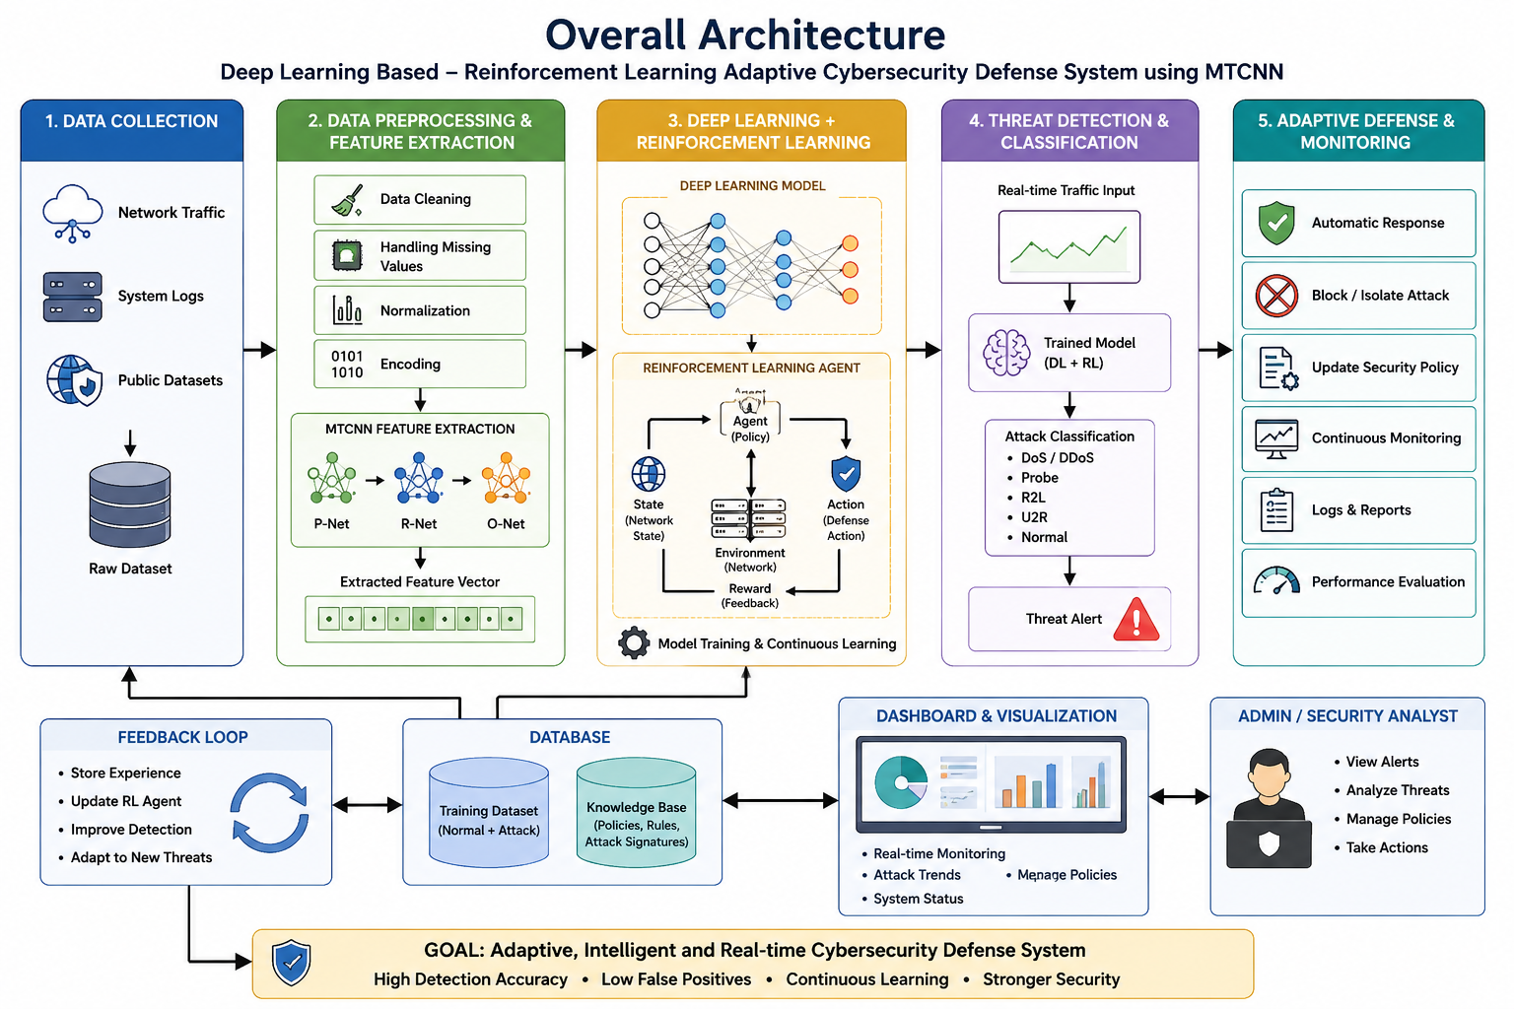

Slide 9
Conclusion
Developed an intelligent cybersecurity defense system using deep learning and reinforcement learning.
MTCNN improves feature extraction for accurate threat detection.
The system adapts to new and evolving cyberattacks automatically.
Provides real-time detection, faster response, and improved network security.
Reduces false alarms and enhances overall cybersecurity performance.
Offers a scalable and reliable solution for modern cyber defense.

Slide 10


